Slide 1
Precedence Constraints and Dependencies

Slide 2
In classical scheduling theory, the jobs are said to have precedence constraints if they are constrained to execute in some order.
Otherwise, if the jobs can execute in any order, they are said to be independent.

Slide 3
Eg.
In a radar surveillance system, the signal-processing task is the producer of track records, while the tracker task is the consumer.
Each tracker job processes the track records generated by a signal-processing job. The designer may choose to
synchronize the tasks so that the execution of the kth tracker job does not begin until the kth signal-processing job completes.

Slide 4
Tracker job is precedence constrained.
In general, a consumer job has this constraint whenever it must synchronize with the corresponding producer job(s) and wait until the latter completes in order to execute.

Slide 5
Eg:
Consider queries to an information server. Suppose that before each query is processed and the requested information retrieved, its authorization to access
the requested information is first checked.
The retrieval job cannot begin execution until the authentication job completes.
The communication job that forwards the information to the requester cannot begin until the retrieval job completes. Similarly, in a communication system, the jobs that generate an acknowledgement of a message and transmit the acknowledgement message cannot begin until the job that receives and processes the message completes.

Slide 6
Precedence Graph and Task Graph
Jobs in a task whether periodic, aperiodic or sporadic may be constrained to execute in particular order
We use a partial-order relation <, called a precedence relation.
Job Ji is a predecessor of another job Jk (and Jk
a successor of Ji) if Jk cannot begin execution until the execution of Ji completes. It is given by Ji < Jk.
Ji is an immediate predecessor of Jk (and Jk is an
immediate successor of Ji) if Ji < Jk and there is no other job Jj such that Ji < Jj < J

Slide 7
Two jobs Ji and Jk are independent when neither Ji < Jk nor Jk < Ji .
A job with predecessors is ready for execution when the time is at or after its release time and all of its predecessors are completed.
Precedence graph can represent the precedence constraints among jobs in a set J using a directed graph G=(J,<).

Slide 8
Precedence Graph:
Each vertex in the graph represent job.
There is directed edge from vertex Ji to Jk when job Ji is an immediate predecessor of job Jk.
Task graph
It is an extended precedence graph.
It uses different types of edges to represent the different dependencies.

Slide 9
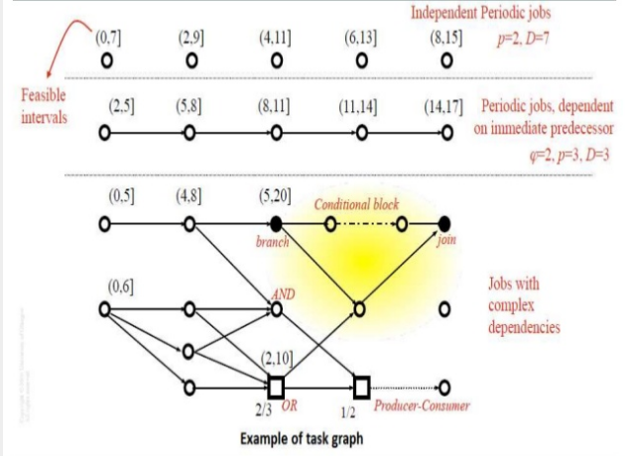

Slide 10
Numbers in the bracket above each job give its feasible
interval.
The edges in the graph represent dependencies among jobs.
If all the edges are precedence edges, representing precedence constraints, then the graph is a precedence graph.

Slide 11
Figure shows two periodic tasks.
The task whose jobs are represented by the vertices in the top row has phase 0, period 2, and relative deadline 7.
-Jobs in it are independent
- No edges to or from these jobs.
- Jobs released in later periods are ready for execution as soon as they are released even though some job released earlier is not yet complete. This is the usual assumption about periodic tasks.

Slide 12
The vertices in the second row of Figure 3–1 represent - Jobs in a periodic task with phase 2, period 3, and relative deadline 3.
- Jobs in it are dependent.
- First job is the immediate predecessor of the second job, the second job is the immediate successor.

Slide 13
Data Dependencies
Data dependency cannot be captured by a precedence graph.
In many Real time systems, jobs communicate via shared data.
Each producer places the data generated by it in a shared address space to be used by the consumer at any time.
Producer and consumer are independent because they are not explicitly constrained to execute in turn.

Slide 14
Eg.
In an avionics system,
- Navigation job updates the location of the airplane periodically.
- These data are placed in a shared space.
- Whenever the flight management job needs navigation data, it reads the most current data produced by the navigation job.
- There is no precedence constraint between the navigation job and the flight management job.

Slide 15
In a task graph, dependencies among jobs are represented explicitly by data dependency.
There is a data-dependency edge from a vertex Ji to vertex Jk in the task graph if the job Jk consumes data generated by Ji or the job Ji sends messages to Jk .
A parameter of an edge from Ji to Jk is the volume of data from Ji to Jk

